Slide 1
GSBA 511: Managerial Economics
Prof. Akbulut
Chapter 16

Slide 2
Chapter 16: Outline
Capturing Consumer Surplus
Price Discrimination
First-Degree, Second-Degree, Third-Degree Price Discrimination
Intertemporal Price Discrimination and Peak-Load Pricing
Cost Plus Pricing
Two-Part Tariff

Slide 3
Capturing Consumer Surplus
P, $ per unit
90
The firm could increase surplus if it could charge different prices to consumers with different willingness to pay.
60
30
MC
Demand
MR
0
30
90
Q
, Units per d
a
y

Slide 4
Capturing Consumer Surplus
Price Discrimination:
Practice of charging different prices to different consumers for similar goods.
Yield Management:
A sophisticated form of price discrimination in which firms rapidly adjust the prices of their goods and services based on the preferences of consumers and their responsiveness to changes in prices.

Slide 5
When is Price Discrimination Feasible
Price-discrimination will not be feasible or possible unless:
The seller possesses market power—meaning, the seller faces a downward sloping demand curve.
The seller is capable of segregating buyers into groups based on differential willingness to pay, or elasticity of demand.
The seller can prevent arbitrage or resale of the product.

Slide 6
Yield Management
Yield Management is used by firms with extremely perishable goods, or by firms with services that cannot be stored.
Examples: Airlines, Hotels, Colleges, Car rental;

Slide 7
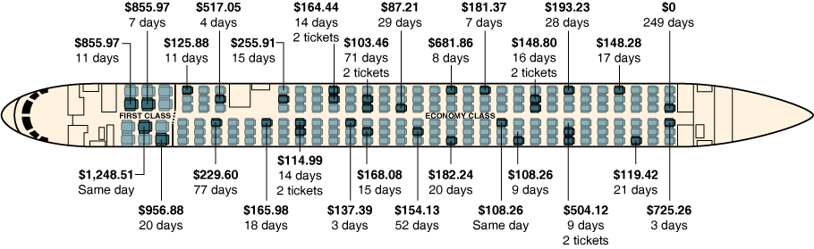
Airlines: The Kings of Price Discrimination
The 33 passengers on this United Airlines flight from Chicago to Los Angeles paid 27 different prices for their tickets, including one passenger who used frequent flyer miles to obtain a free ticket.
The first number in the figure is the price paid for the ticket;
the second number is the number of days in advance that the ticket was purchased.

Slide 8
First-Degree Price Discrimination
Reservation Price
Maximum price that a customer is willing to pay for a good.
First-Degree Price Discrimination
Practice of charging each customer her reservation price.

Slide 9
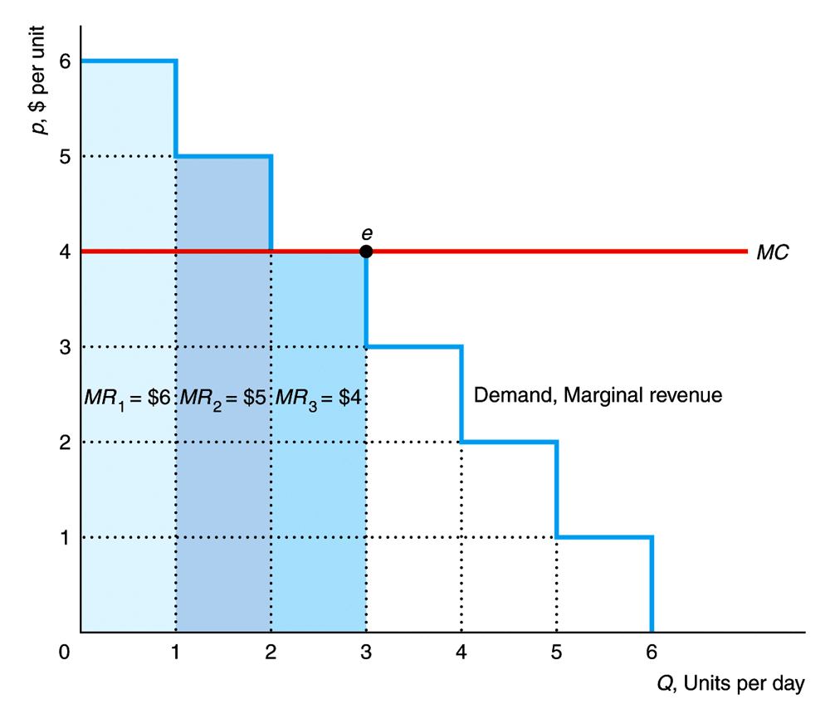
First-Degree (Perfect) Price Discrimination

Slide 10
First-Degree (Perfect) Price Discrimination
P, $ per unit
p
1
A
MC
e
s
p
s
B
C
p
=
MC
e
c
c
c
E
D
Demand,
MR
D
1
MR
s
Q
s
Q
c
=
Q
d
Q
, Units per d
a
y

Slide 11
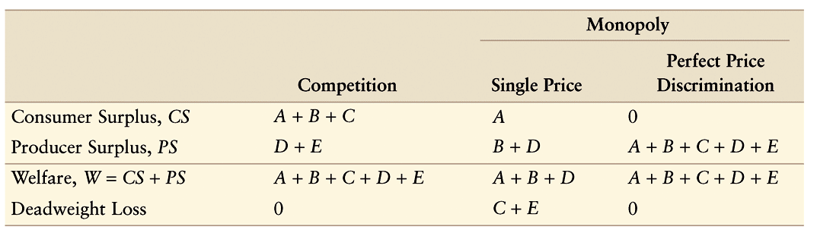
Welfare Comparisons

Slide 12
Second-Degree Price Discrimination
Second-Degree Price Discrimination
Practice of charging different prices per unit for different quantities of the same good or service.
Block Pricing
Practice of charging different prices for different quantities or “blocks” of a good.

Slide 13
Third-Degree Price Discrimination
Third-Degree Price Discrimination also called Multimarket Pricing
Practice of dividing consumers into two or more groups with separate demand curves and charging different prices to each group.

Slide 14
Third-Degree Price Discrimination
If third-degree price discrimination (creating consumer groups) is feasible, how should the firm decide what price to charge each group of consumers?
We know that however much is produced, total output should be divided between the groups of customers so that marginal revenues for each group are equal.
We know that total output must be such that the marginal revenue for each group of consumers is equal to the marginal cost of production.

Slide 15






Third-Degree Price Discrimination
Creating Consumer Groups
Determining Relative Prices

Slide 16
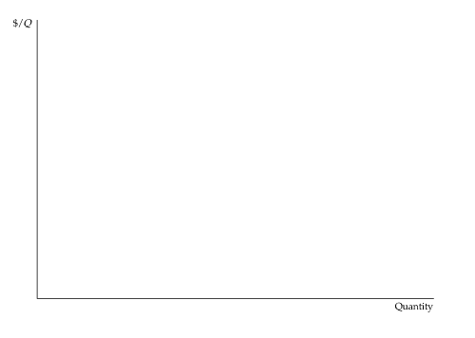
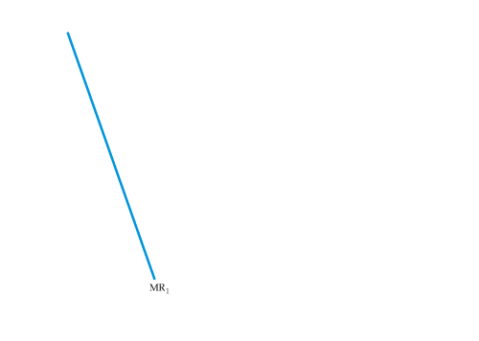
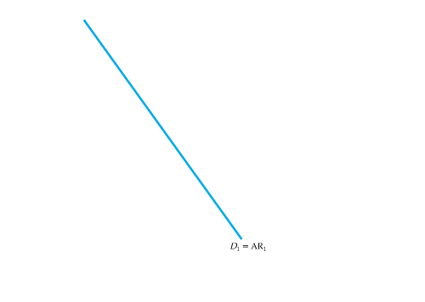
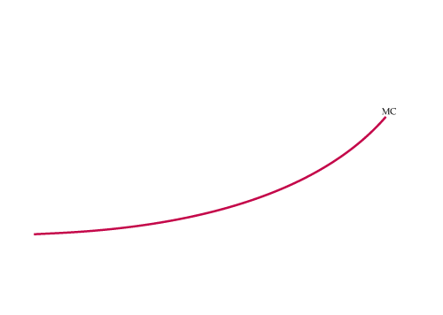
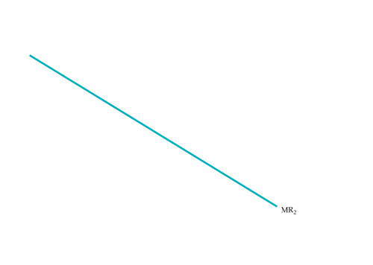
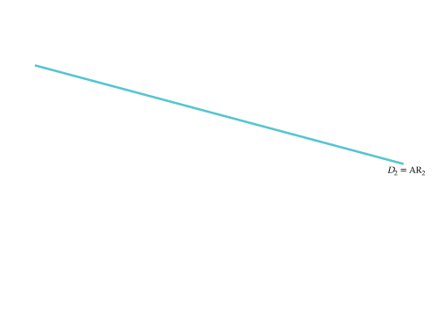
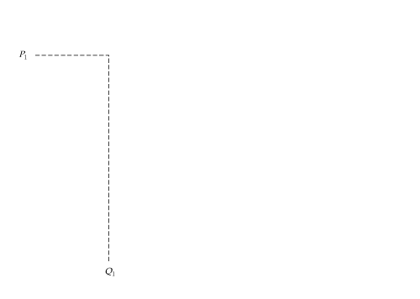
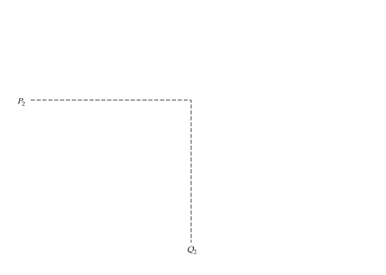
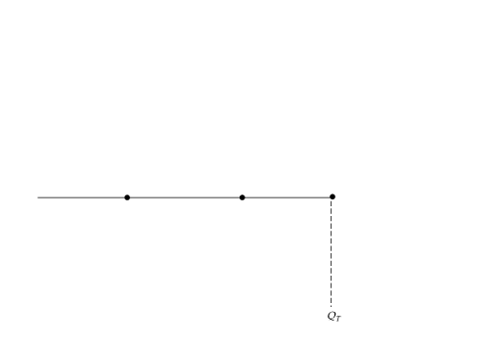
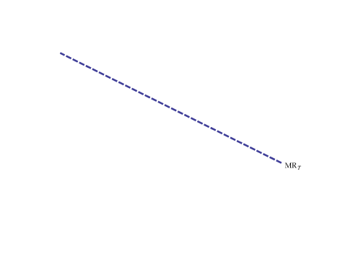
Third-Degree Price Discrimination
Consumers are divided into 2 groups, with separate demand curves.
Note that Q₁ and Q₂ are chosen so that
MR₁ = MR₂ = MC.

Slide 17
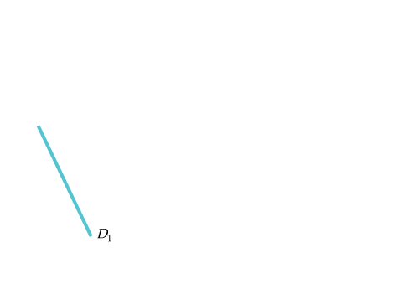
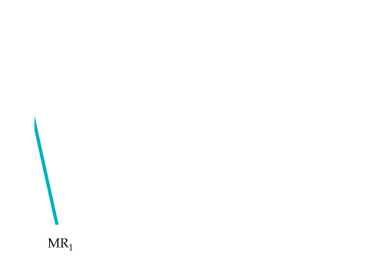
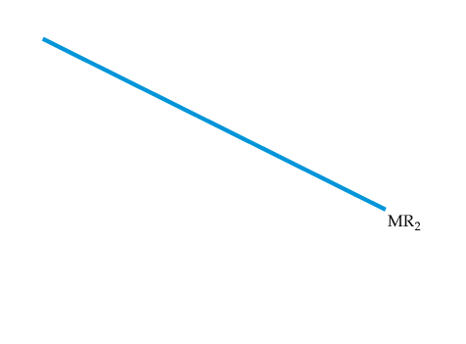
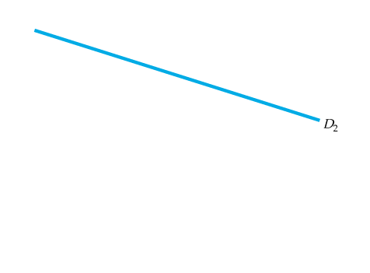
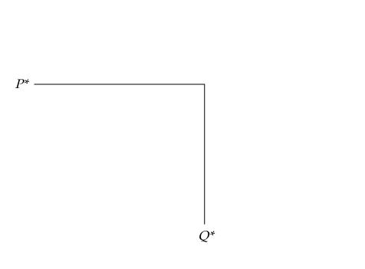
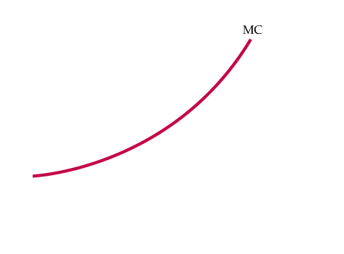
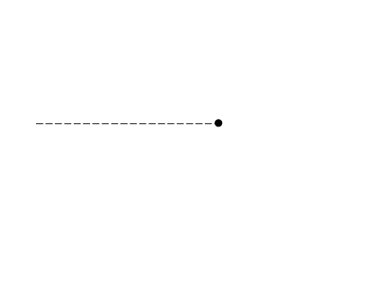
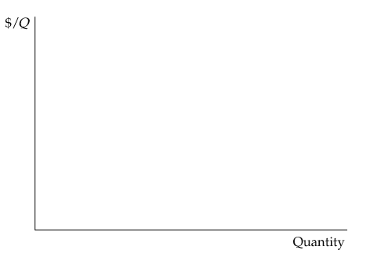
Third-Degree Price Discrimination
No Sales to Smaller Market
If MC is rising, it may not pay to sell to both groups.
Here the first group, with demand D₁, is not willing to pay much for the product.
It is unprofitable to sell to them because the price would have to be too low to compensate for the resulting increase in MC.

Slide 18
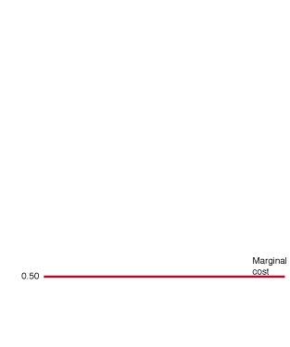

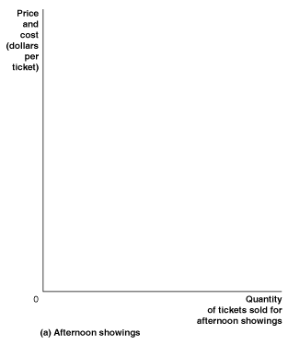
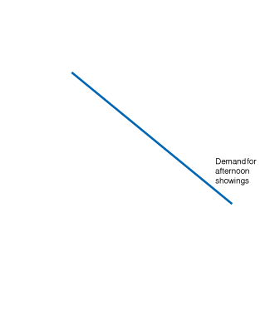
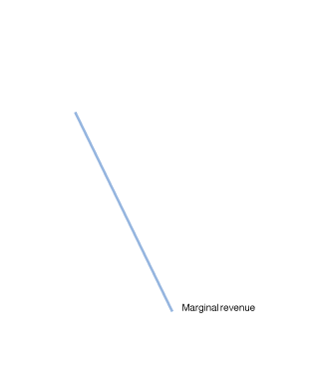
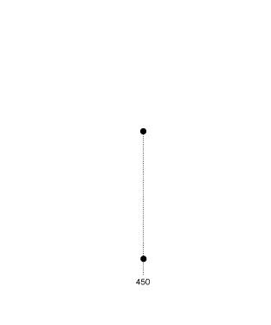
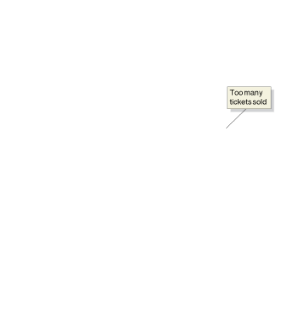
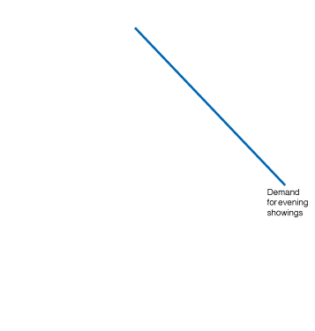
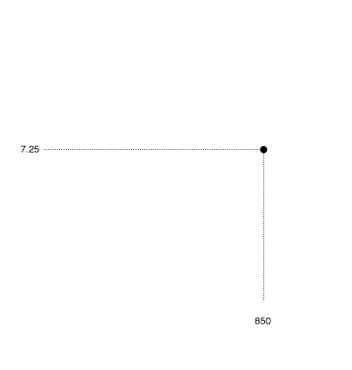
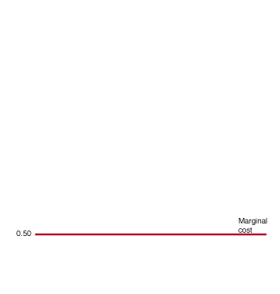
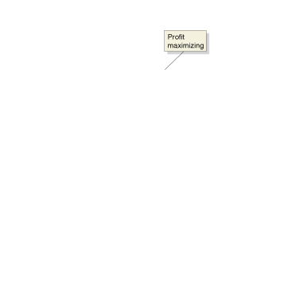
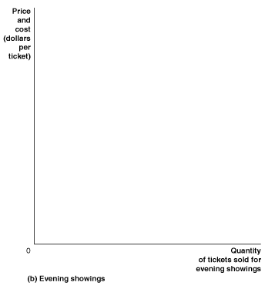
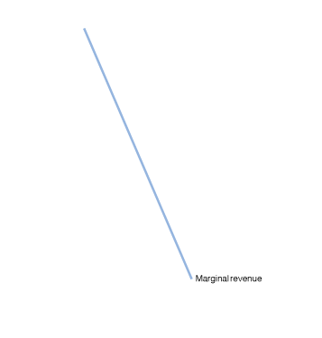
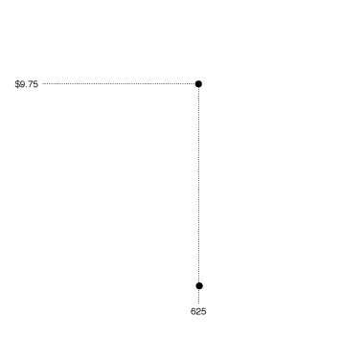
Price Discrimination by a Movie Theater

Slide 19
Other Pricing Strategies
Intertemporal Price Discrimination:
Practice of separating consumers with different demand functions into different groups by charging different prices at different points in time.
Peak-Load Pricing
Practice of charging higher prices during peak periods when capacity constraints cause marginal costs to be high.

Slide 20
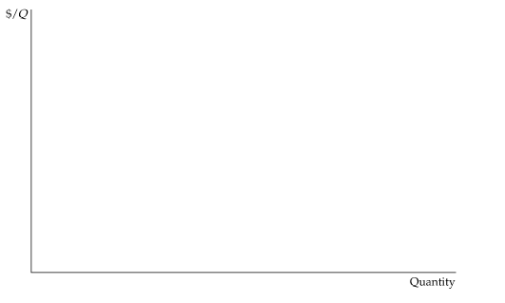
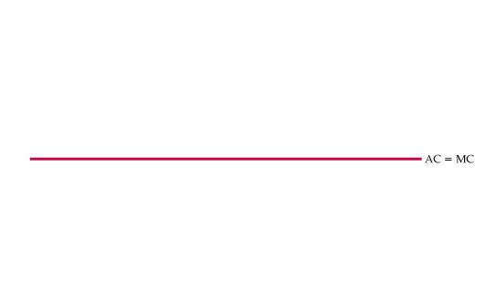
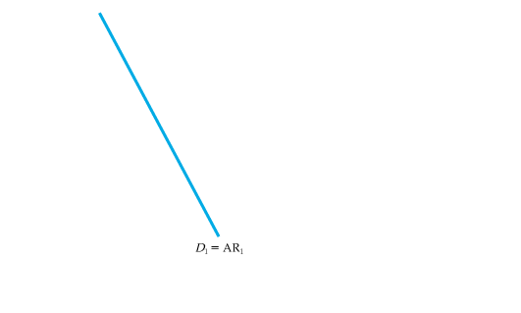
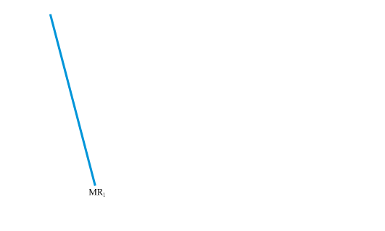
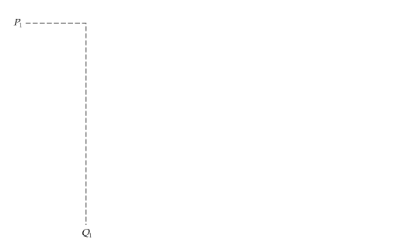
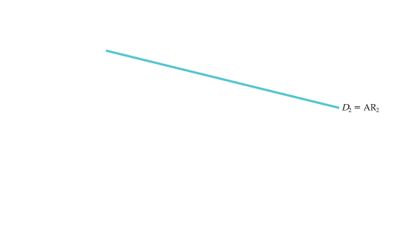
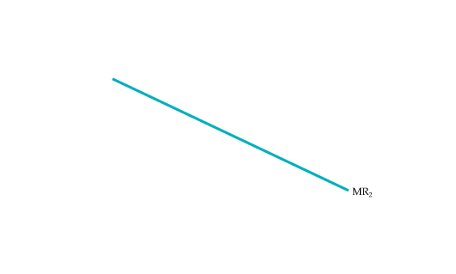
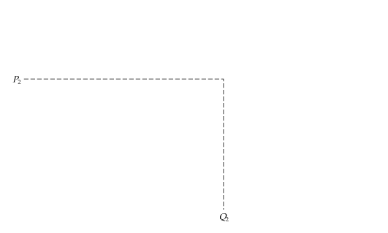
Intertemporal Price Discrimination
Consumers are divided into groups by changing the price over time.
Initially, the price is high. The firm captures surplus from consumers who have a high demand for the good and who are unwilling to wait to buy it.
Later the price is reduced to appeal to the mass market.

Slide 21
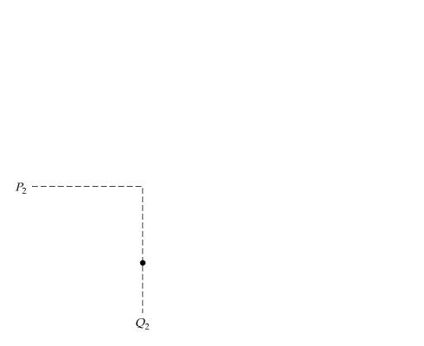
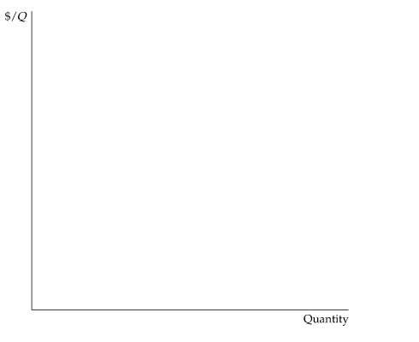
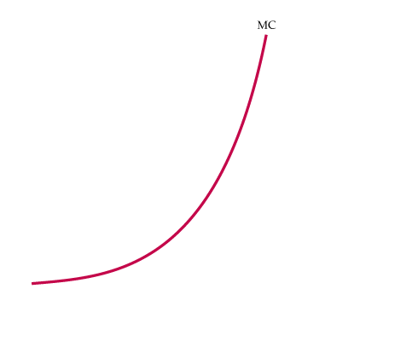
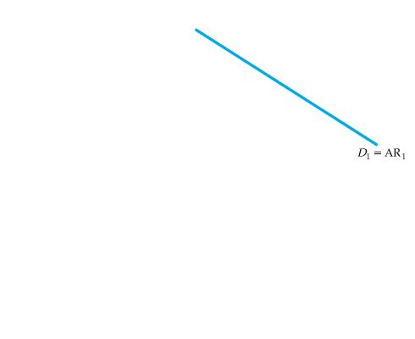
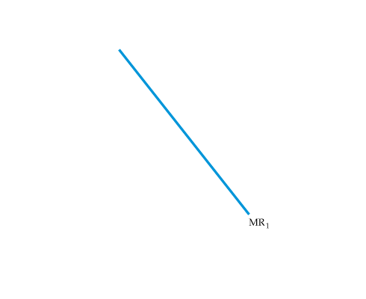
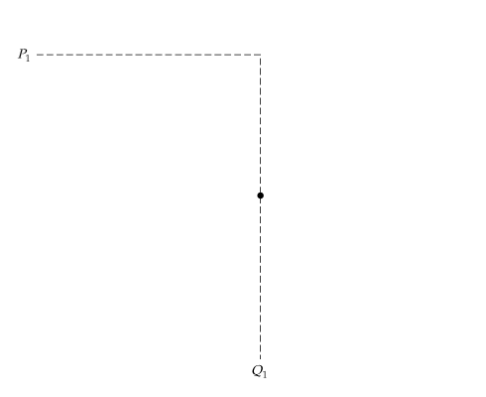
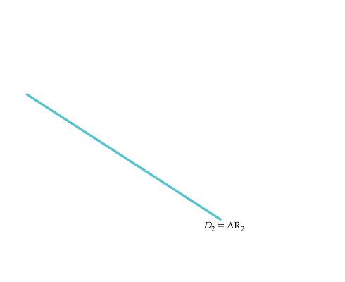
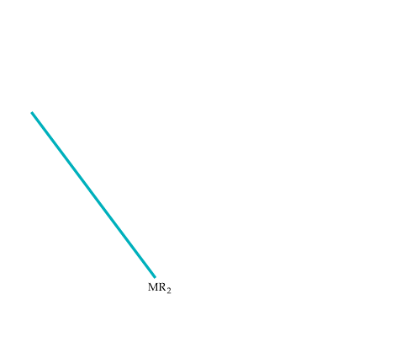
Peak-Load Pricing
During times of the day or year where demand peaks, a higher price, P₁, is charged.
This is more profitable for the firm than charging a single price at all times.
It is also more efficient because marginal cost is higher during peak periods.

Slide 22
Other Pricing Strategies
Cost-Plus Pricing: adding a percentage markup to average total cost
higher markup when demand is price inelastic
Two-Part Tariffs: initial fee for the right to buy the product and an additional fee for each unit of the product purchased

Slide 23
Two-Part Tariff with a Single Type of Consumer
$/Q
User price P* is set at
MC. Entry price T*
is equal to the entire
consumer surplus.
T*
MC
P*
D
Quantity

Slide 24
Two-Part Tariff with Two Types of Consumers
$/Q
The price, P*, will be
greater than MC. Set T*
at the surplus value of D_{2.}
T*
A
P*
MC
B
C
D₁ = consumer 1
D₂ = consumer 2
Q₂
Q₁
Quantity

Slide 25
Two-Part Tariff with Many Different consumers
No exact way to determine P* and T*.
Must consider the trade-off between the entry fee T* and the use fee P*.
Low entry fee: High sales and falling profit with lower price and more entrants.
To find optimum combination, choose several combinations of P,T.
Choose the combination that maximizes profit.

